Slide 1
Resource Finder Use Case
Customer 1
Customer 2
Customer 3
Digital agency Contoso requires a solution that allow to internal employees upload and authorize content to finally search them depending on the project, the only restriction they have is that all content needs to be validated by the audit company Northwind in order to prevent any copyright compliance issue. Once documents have been validated, they will be visible for the rest of the organization through the mobile application search.
The application will have two roles for users: approver and user, as user they will have ability to upload files (pdf, jpg, doc) and search them.
All the content submitted is pending for approval, approvers should receive an email/push notification to open the pending approval to accept or reject the content, once the request for upload has been approved it will be saved and visible for search.
Digital Agency Services
Upload and search content in documents & images
Login
Login user as admin or user
Organization: A, B, C
Admin user
Mobile Application
User

Slide 2
Resource Finder Workflow
User login
Content
Operations
Upload content in temporal blob container
Search content
Update status in blockchain
Invoke microservice for search content
Wait for admin approval
Return data to mobile application
Admin
Operations
Blockchain Operations
Notify rejection by email or push notification
Notify approval by email or push notification
Update rejected status in database record
Update approved status in database record
Move document to blob container for rejections
Move document to blob container for approvals
Train Azure Cognitive Search
Ready for new content search

Slide 3
Resource Finder Azure Services
Microservice for: UserLogin
Azure Active Directory | Wallet HD | Azure Key Vault | Cosmos DB
Microservice for:
API Gateway
Microservice for: BlockchainOperations
Azure Logic Apps | Cosmos DB
Microservice for: ContentSearch
Azure Cognitive Search
Blob Container for:
Temporal uploads
Blob trigger function for: ContentUpload
Azure Logic Apps | Cosmos DB

Slide 4



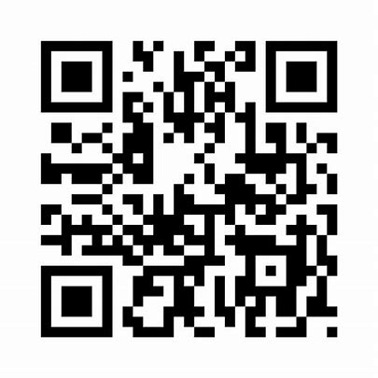







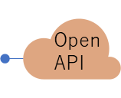
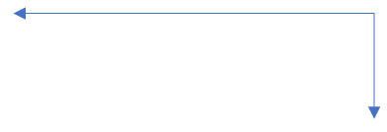






③ User application
② Middle Tier
⑦ Business Intelligence
Member N
Member 1 API Platofrm
Identity
Internal Microservices
AAD
Key Vault
Internal DB
Chain replication DB
Transportation
User
TicketId
Datetime
LocationName
Latitude
Longitude
status
Member 1
Member 2
① Quorum consortium platform + Shared Storage (IPFS)
ERC Tokens for Assets
(ERC20, ER721, …)
Member N
Other Smart Contracts
IPFS Nodes
Hashed content
IPFS
IPFS

